Slide 1
Real-time Volumetric Fog Simulation
Lucia Tódová

Slide 2
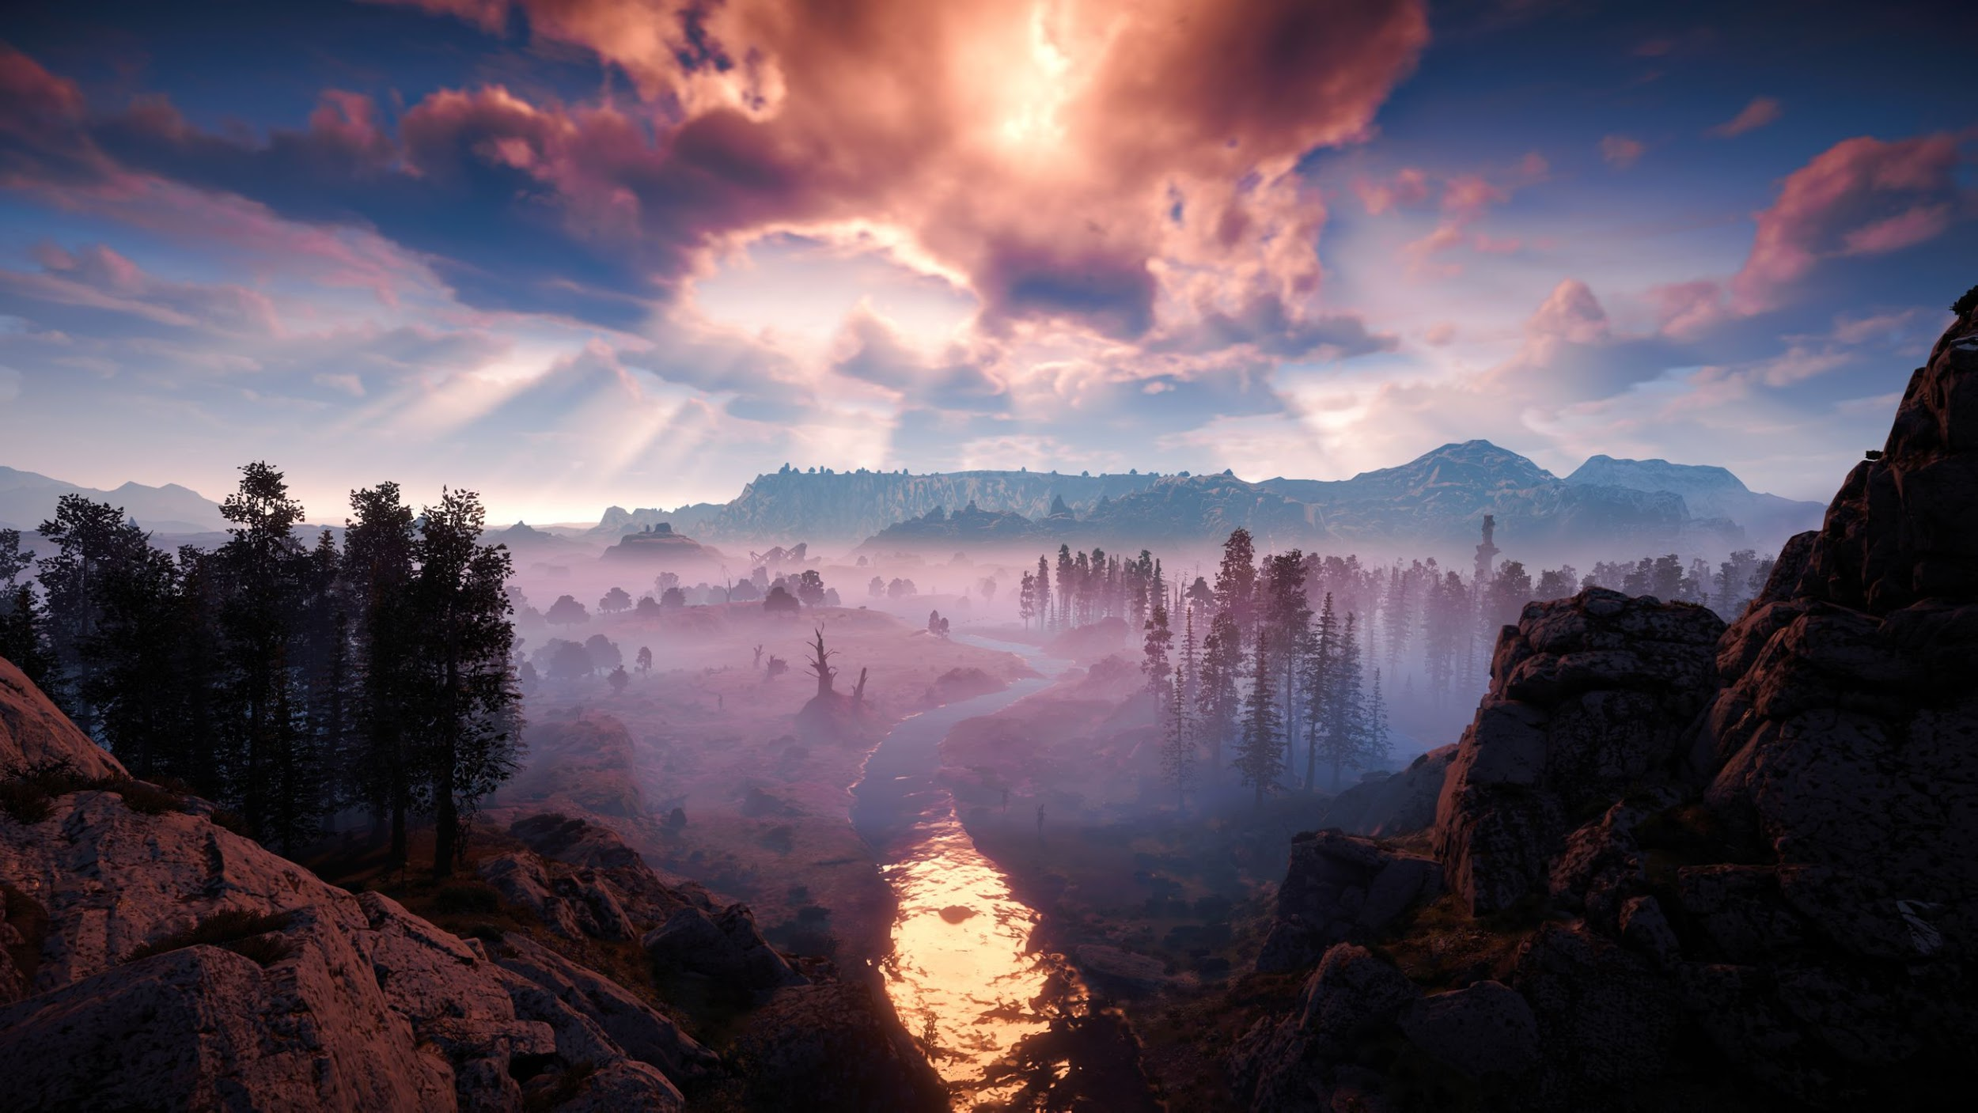
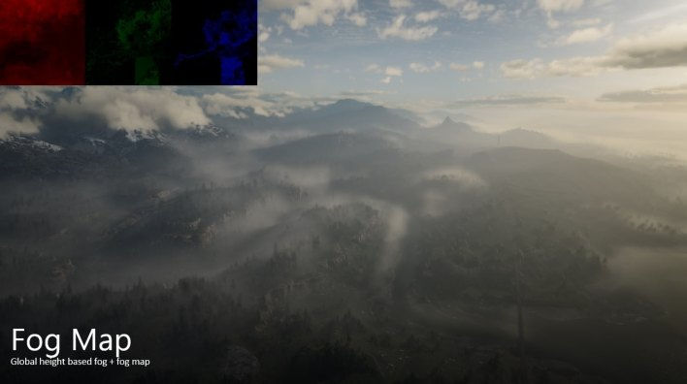
State of the art
Horizon Zero Dawn
Red Dead Redemption 2

Slide 3
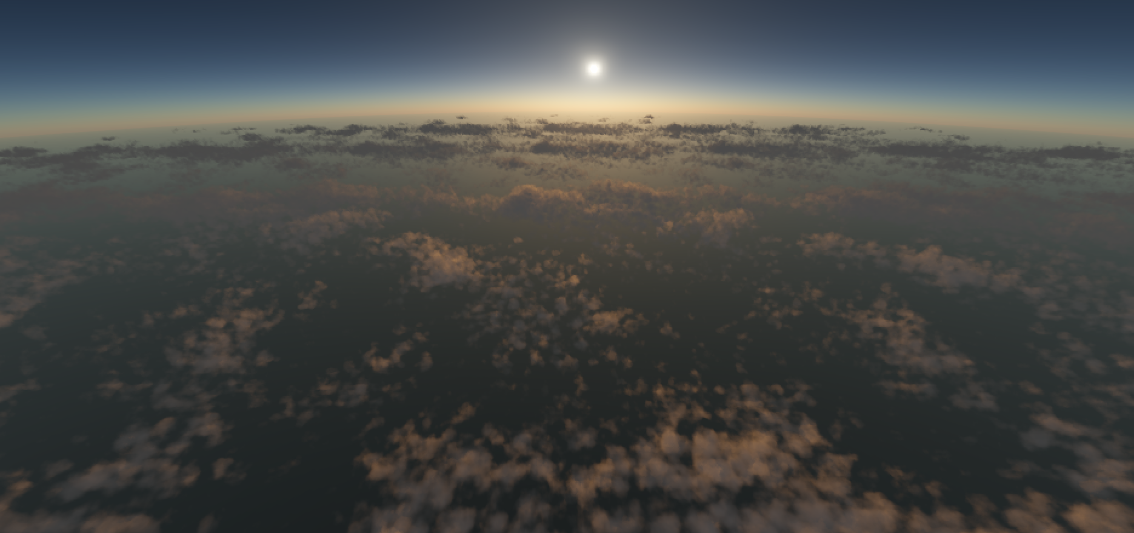
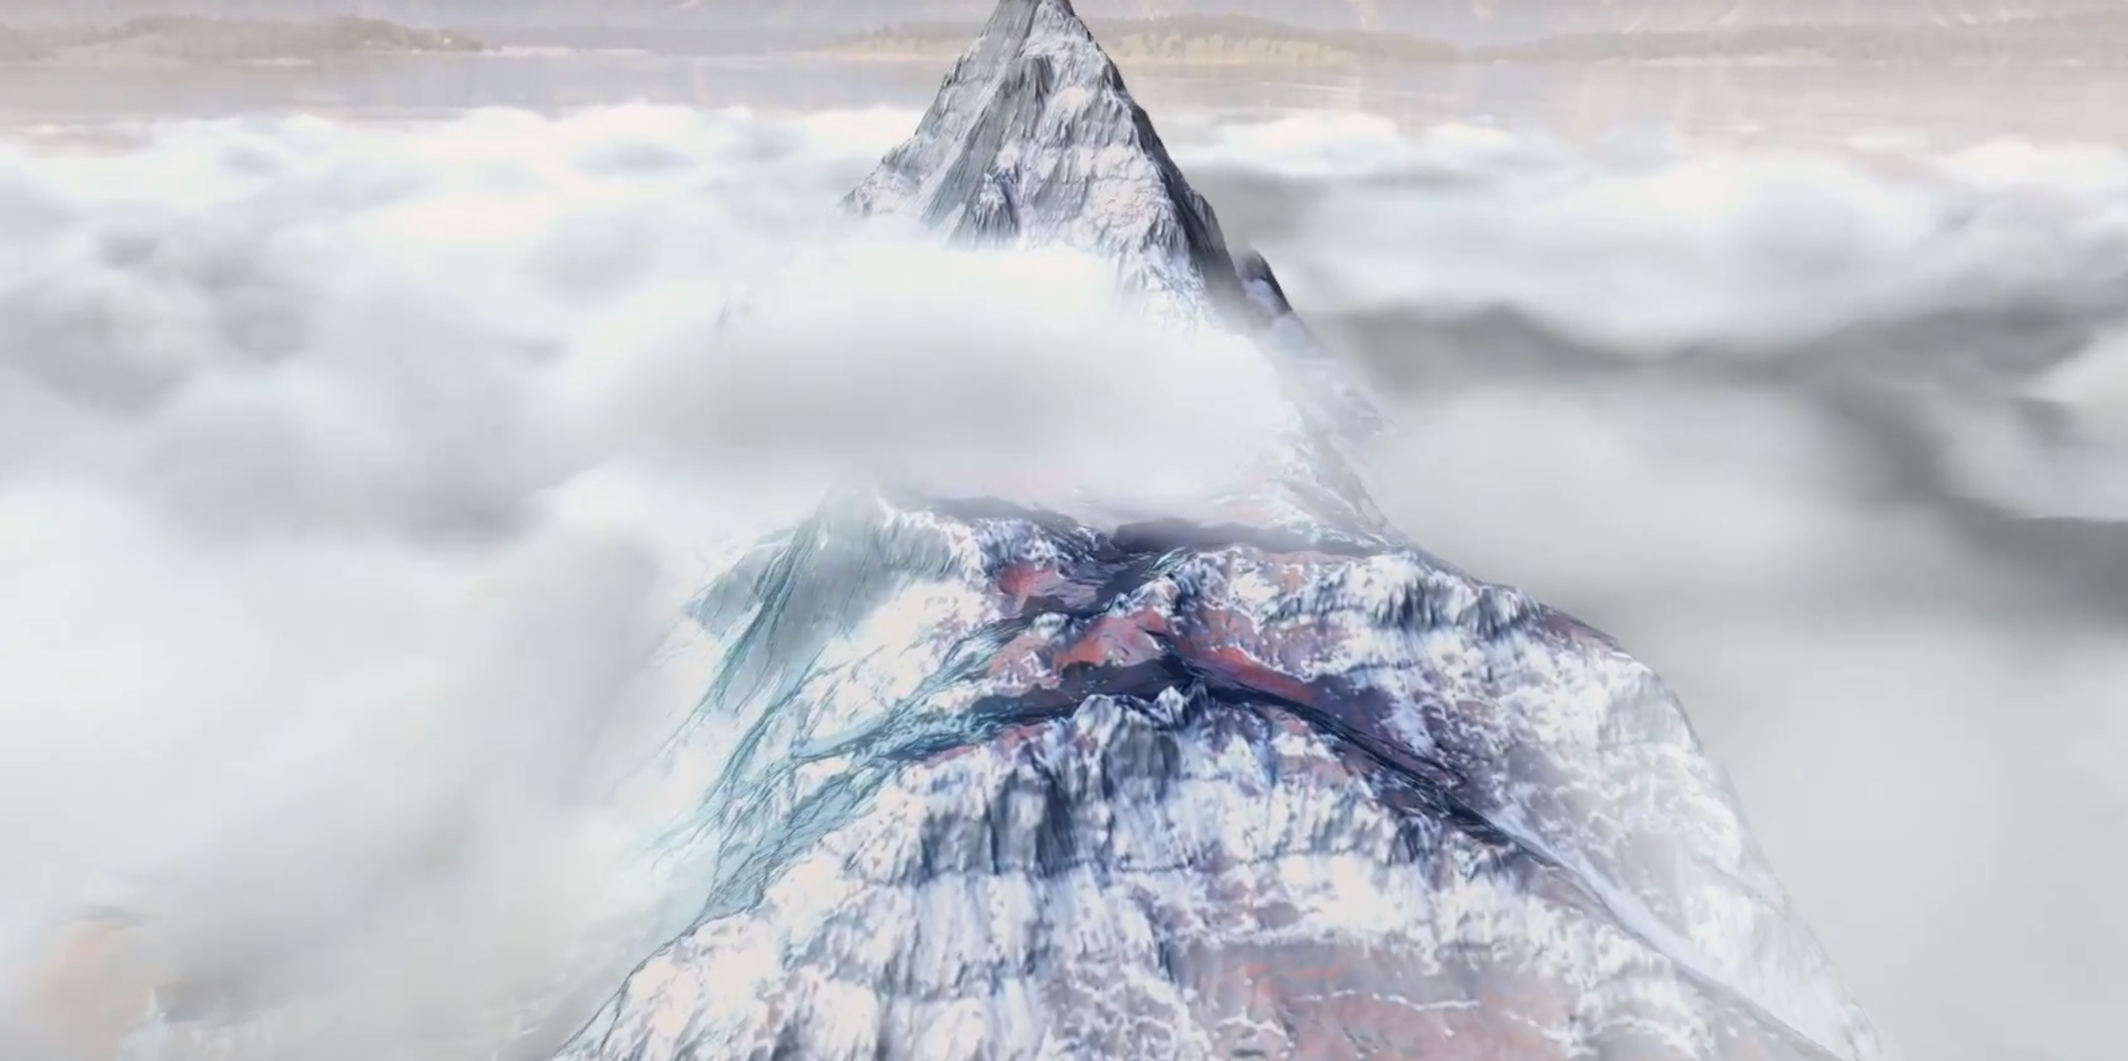
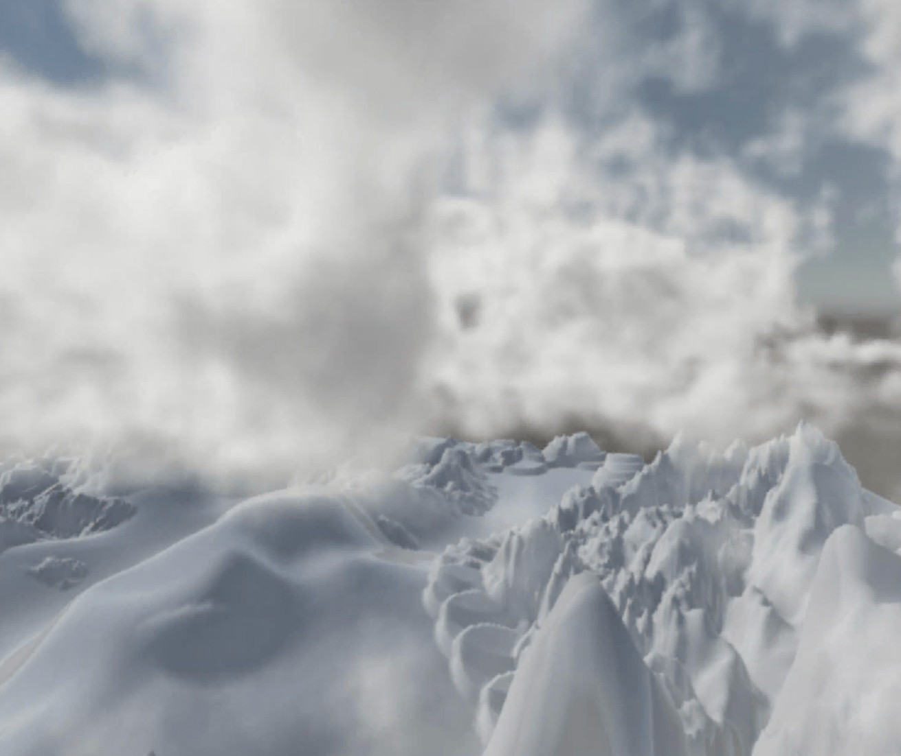

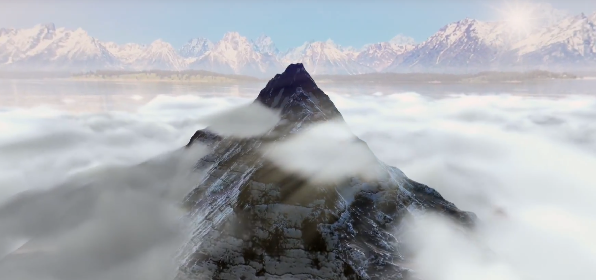
Target result
Real-time Clouds
Volume Cloud for Unity3D
Volumetric Fog&Mist
by Juraj Páleník
by yangrc1234
Unity Asset by Kronnect

Slide 4
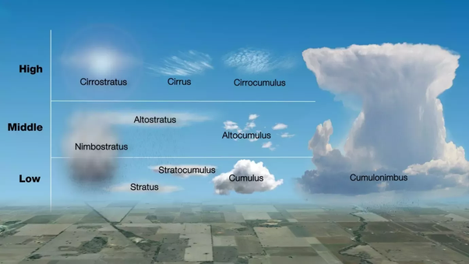
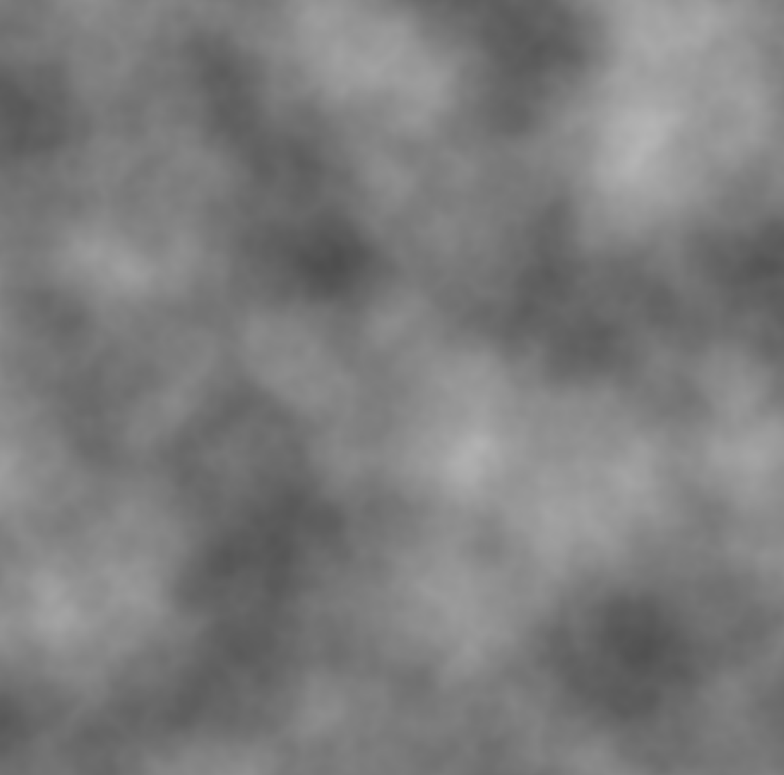
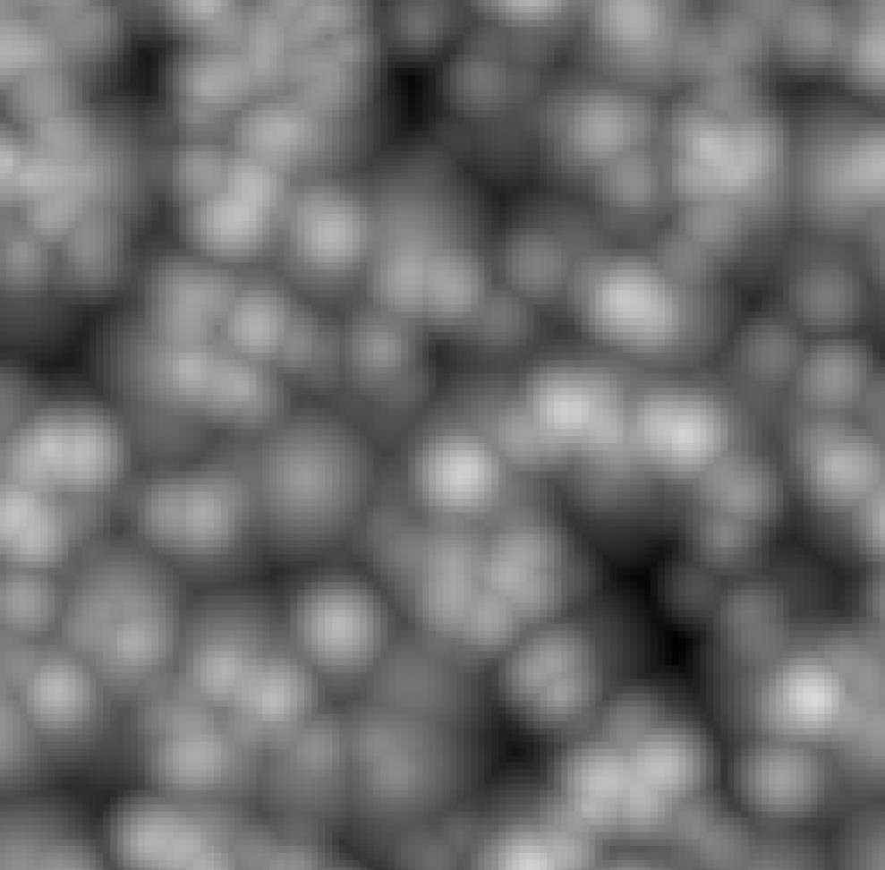
How it works
Modeling
different types of clouds
Weather Map - where clouds form, height (1,500m - 10,000m), density
combination of noises
2. Visualization
Ray marching
Possibly sphere tracing
Perlin noise (fog)
Inverted Worley noise (clouds)

Slide 5
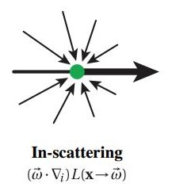
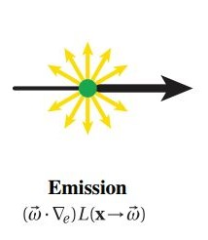
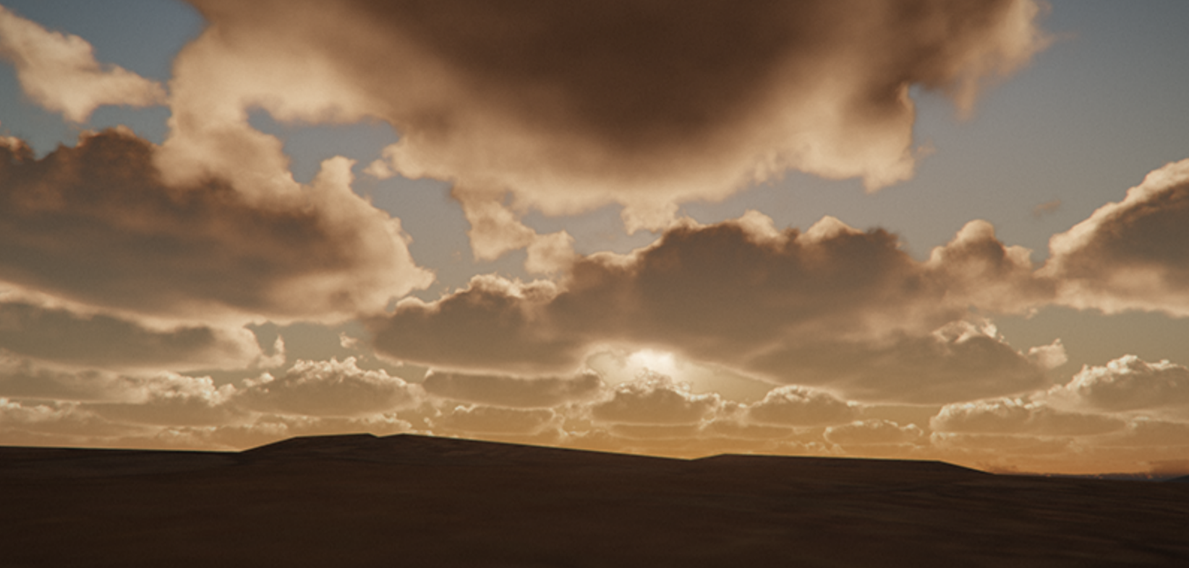
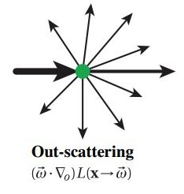
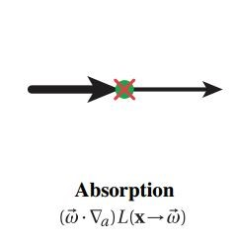
How it works
3. Lighting
Radiance influenced by:
Emission
Absorption
Out-scattering
In-Scattering
Beer’s law - attenuation of light in relation to medium
Using Beer’s law
4. Optimization
Oculus Quest
Ray marching optimizations - step size
Precision of computations

Slide 6
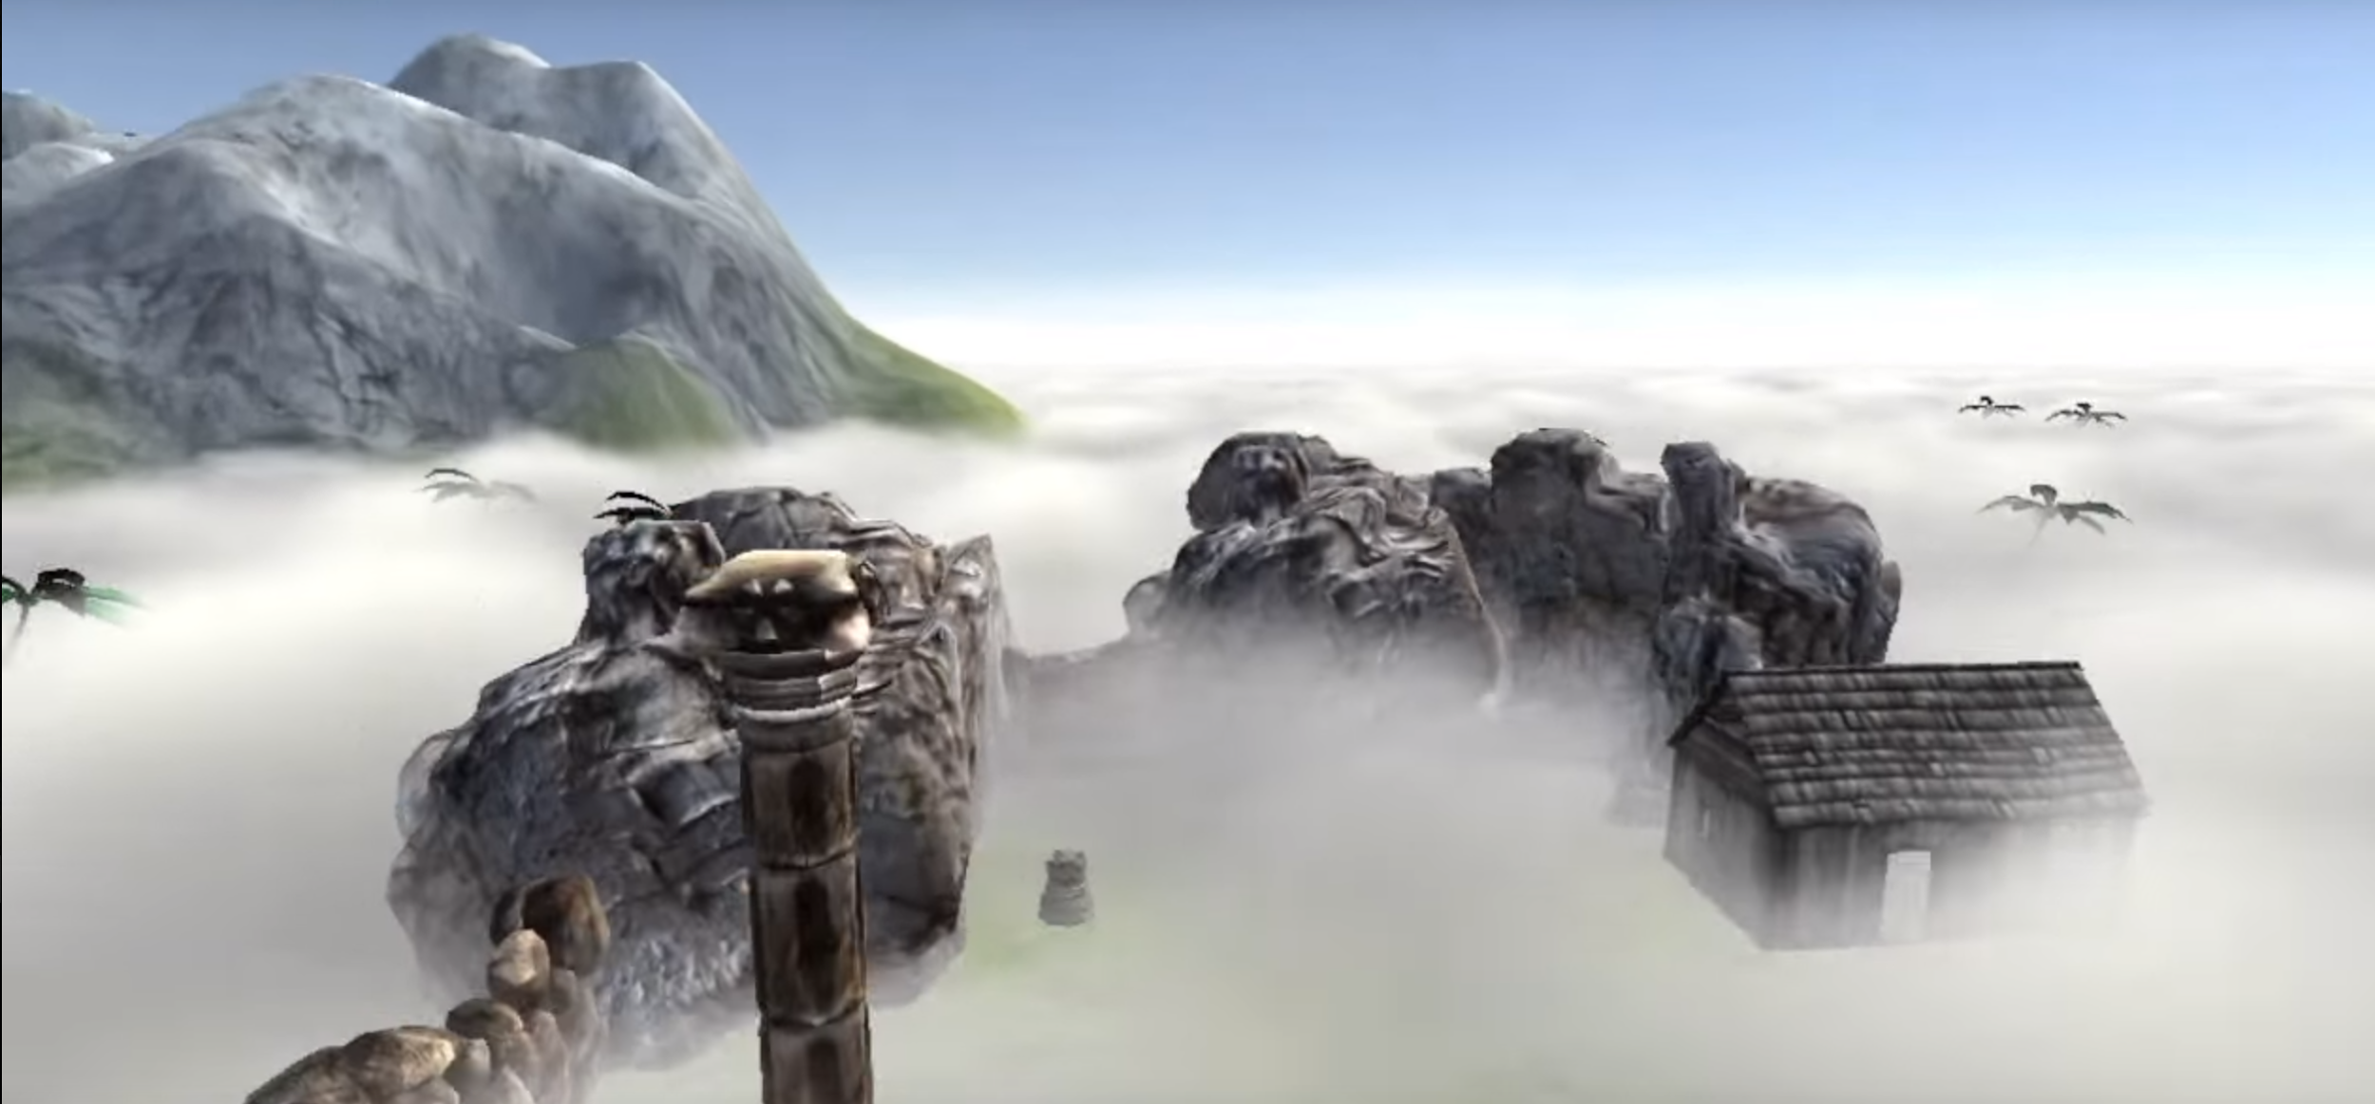

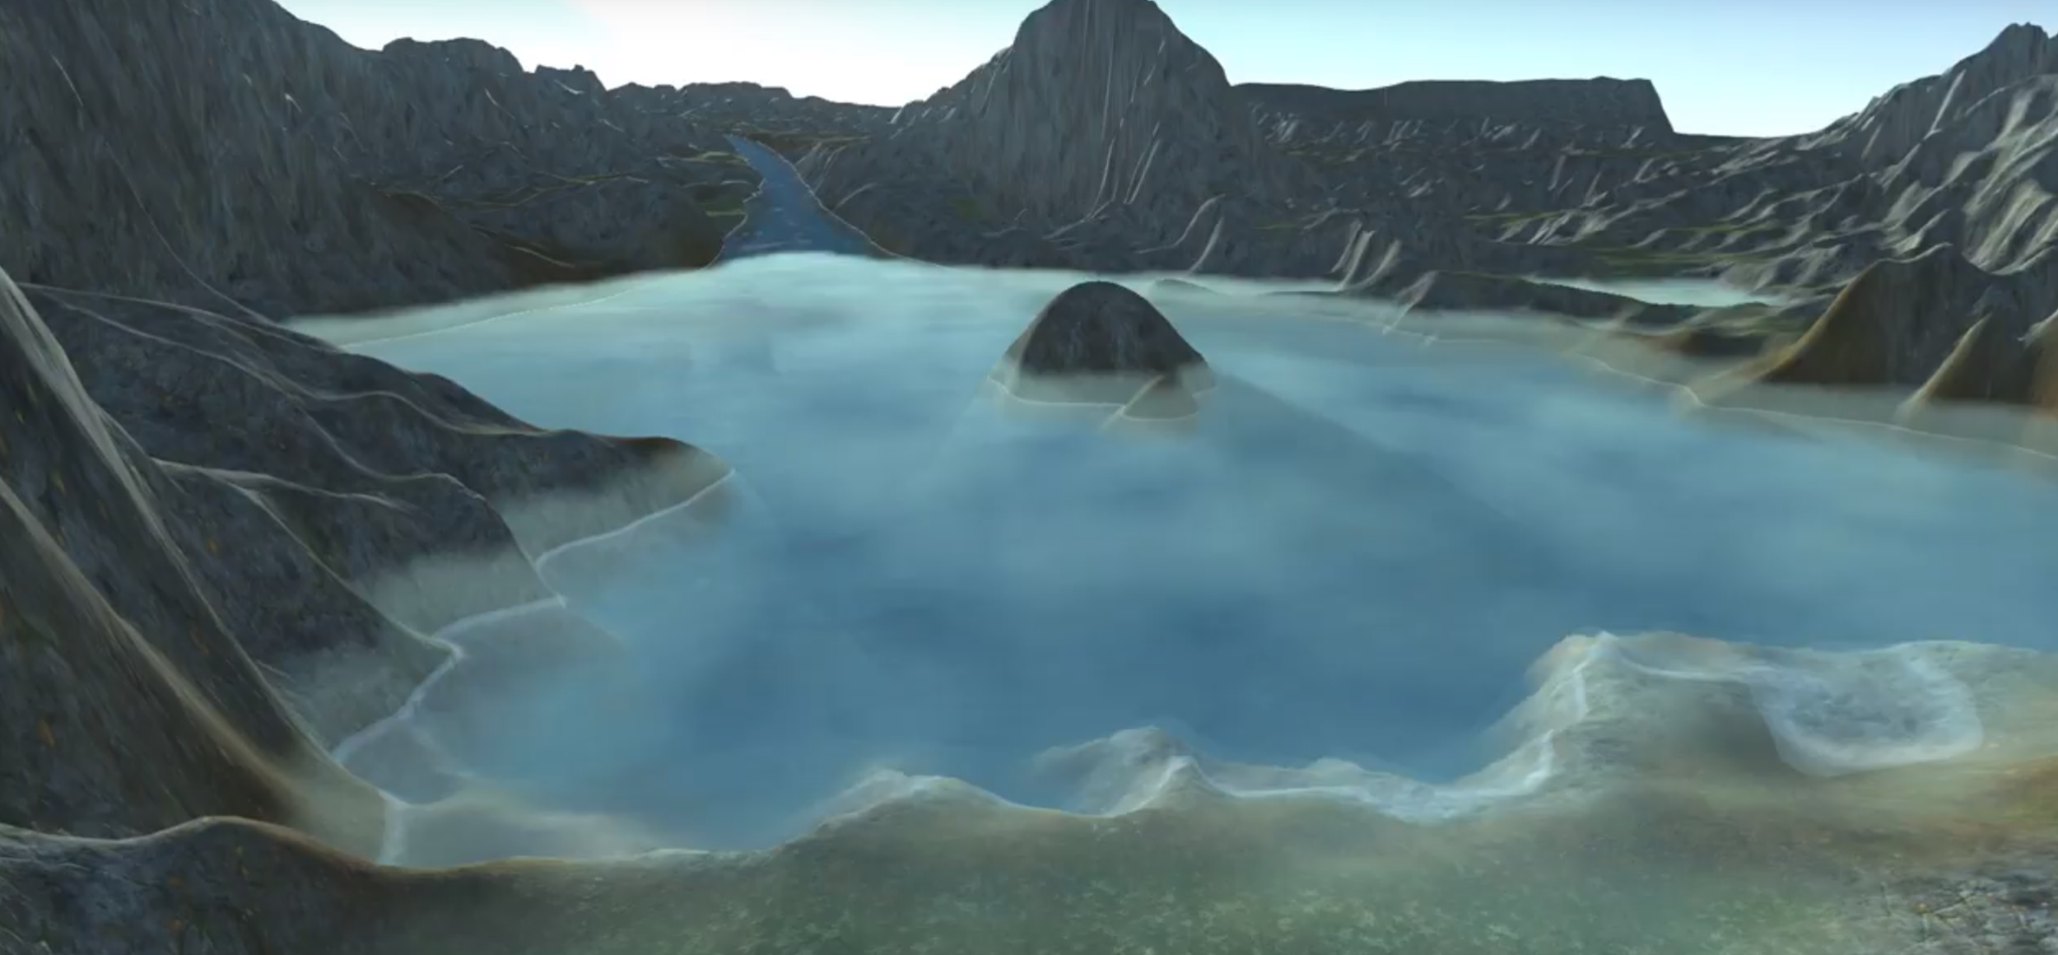

Features
Unity3D asset, start from empty Unity project
Unity shading language
Multiple options:
Perlin noise, Worley noise
Step size
Color
Density
Scaling
Velocity
…
Varying density
(Kronnect)
Varying step size
(Fredrik Haggstrom)

Slide 7
Thank you for your attention!

